Slide 1

BC2410, Prescriptive Analytics From Data to Decision
A brief review of Lecture 1

Slide 2
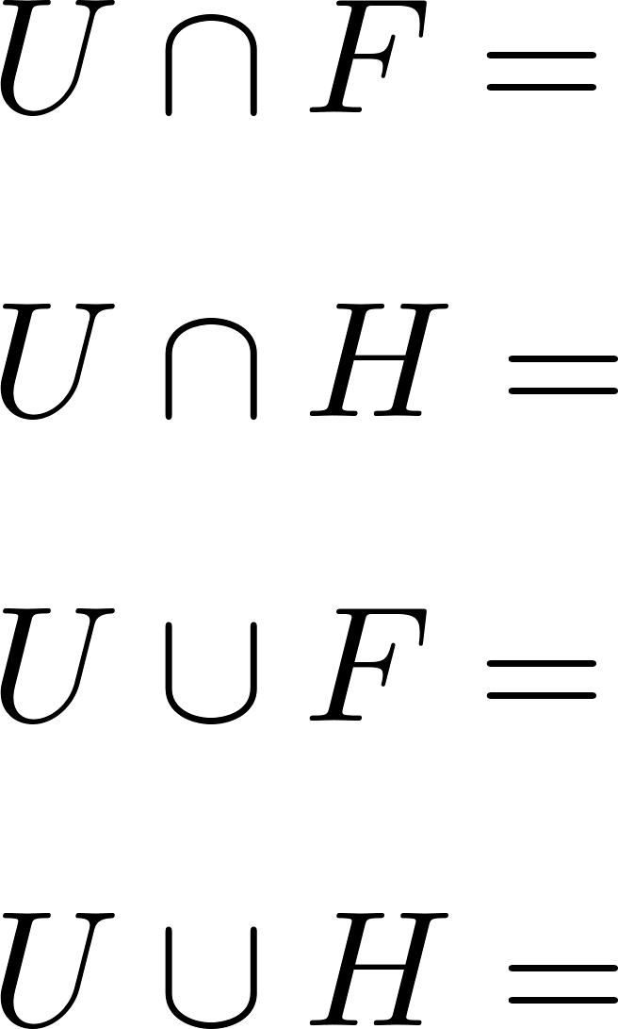
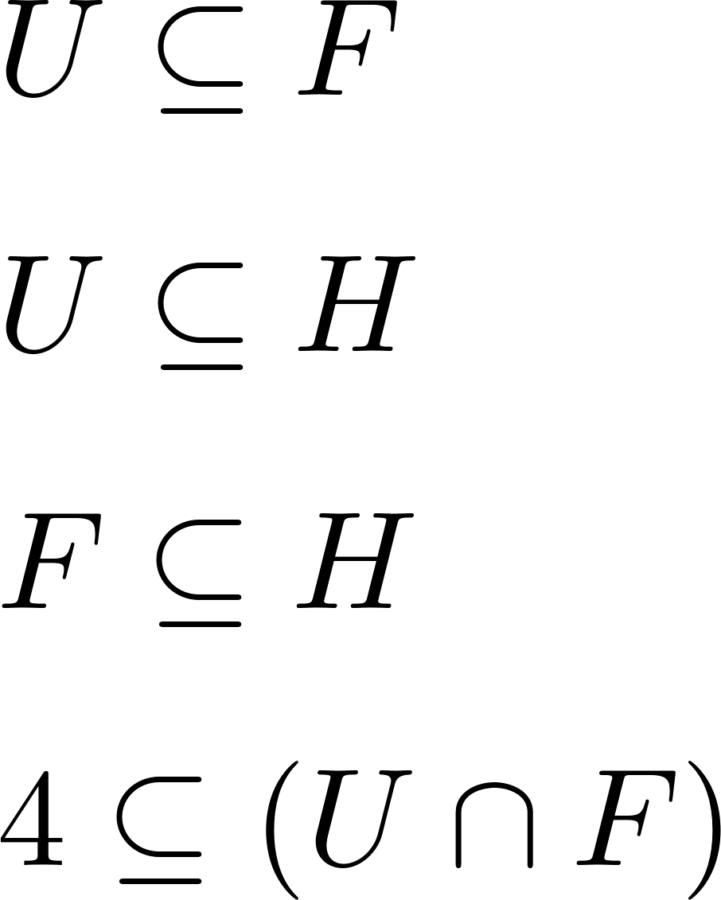
Sets
Calculation
True or False?
Notes:
U U F = [0,5) U {9}
4 is an element, so should either in a set or not in a set

Slide 3
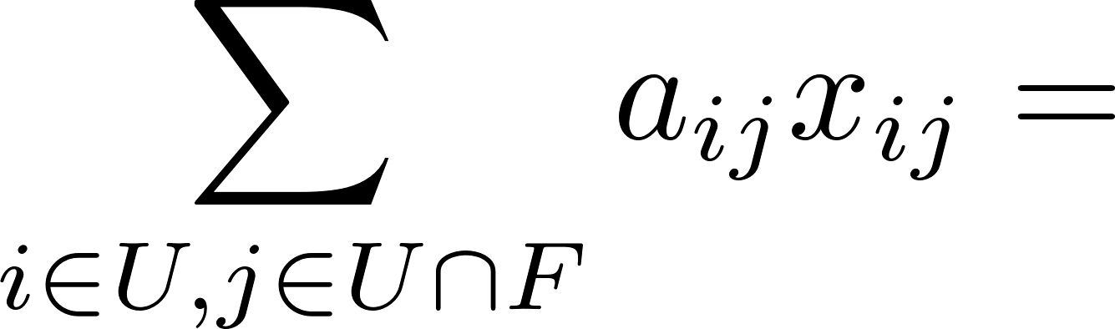
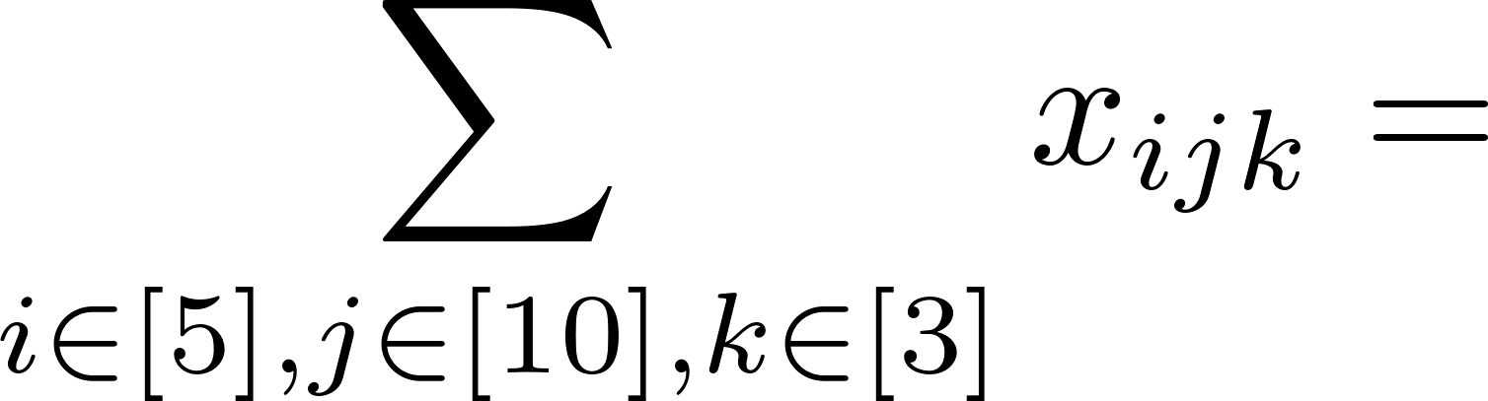
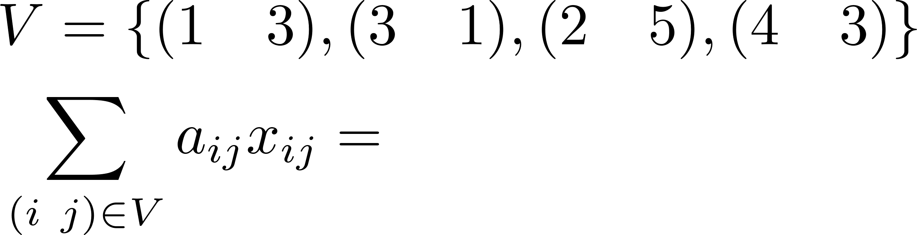
Summation
Let [T] = {1, 2, …, T}, how many terms on the RHS of the following equation?
Notes:
Question 1:
Do it step by step U = {0,1,4,9} U $∩$ F = {0,1,4}
So there should be 12 items on the right hand side.

Slide 4
What is the meaning of this?

Slide 5
Matrix Multiplication
Notes:
A₁x₁ + A₂x₂ + … + A_{n}x_{n}
Try to write down all the elements of A, conduct the matrix multiplication, then you can understand why in this way Same for the problem in the next slides

Slide 6
Matrix Multiplication
Notes:
(a₁^{T}x, a₂^{T}x,, …, a_{m}^{T}x_{m})^{T}

Slide 7
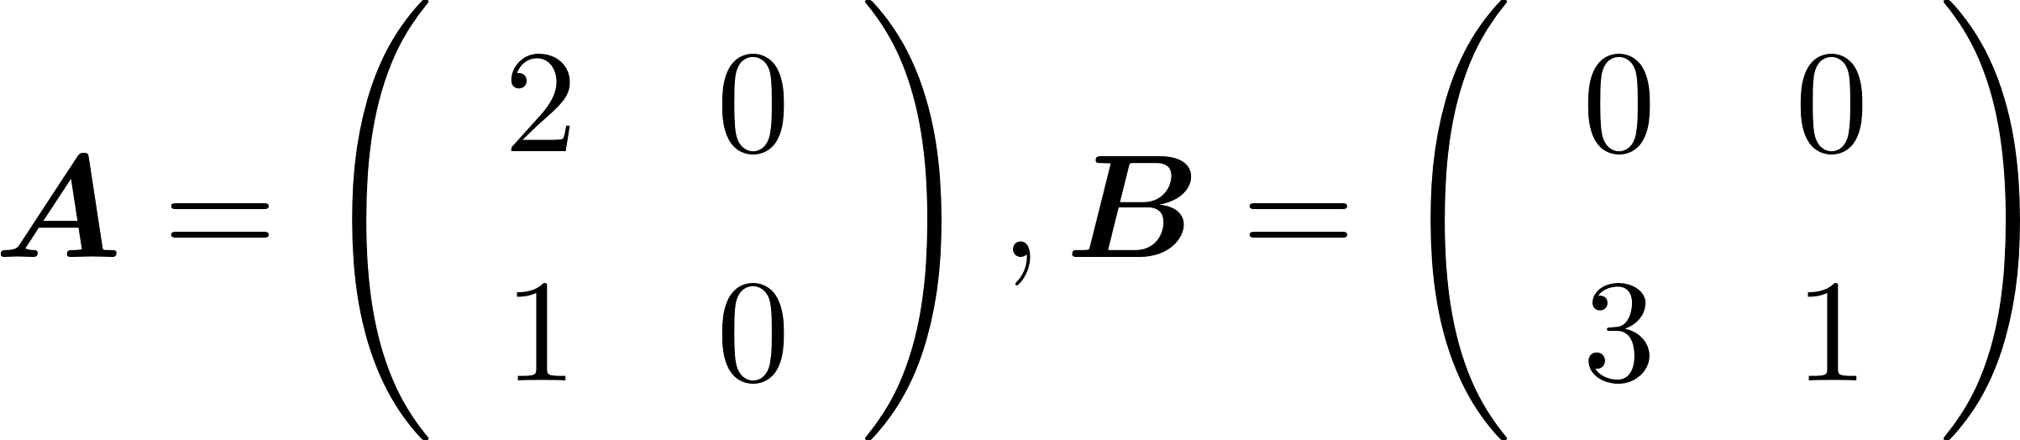
Matrix Multiplication
Let
Determine AB.
Notes:
Obtaining a matrix with all zeros doesn’t mean either A or B will be 0

Slide 8
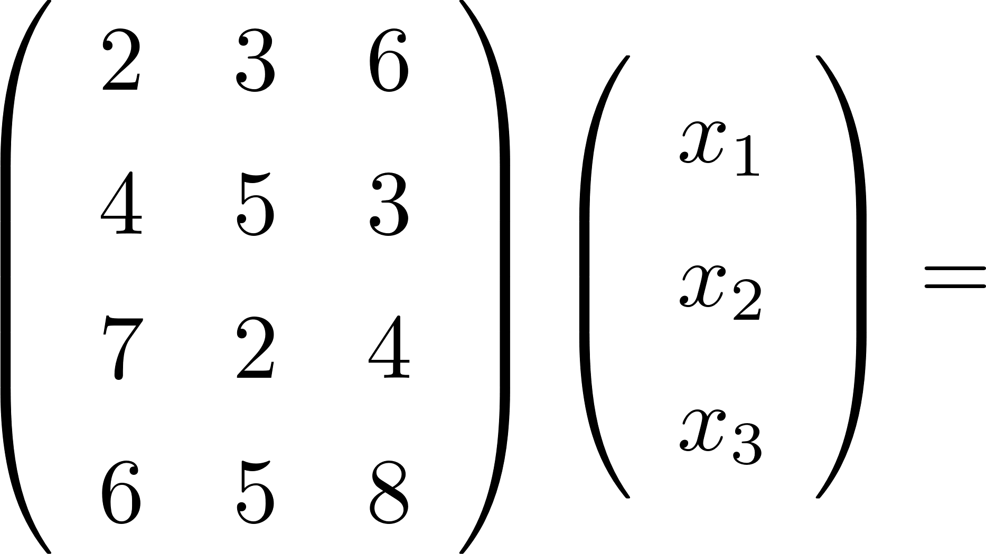
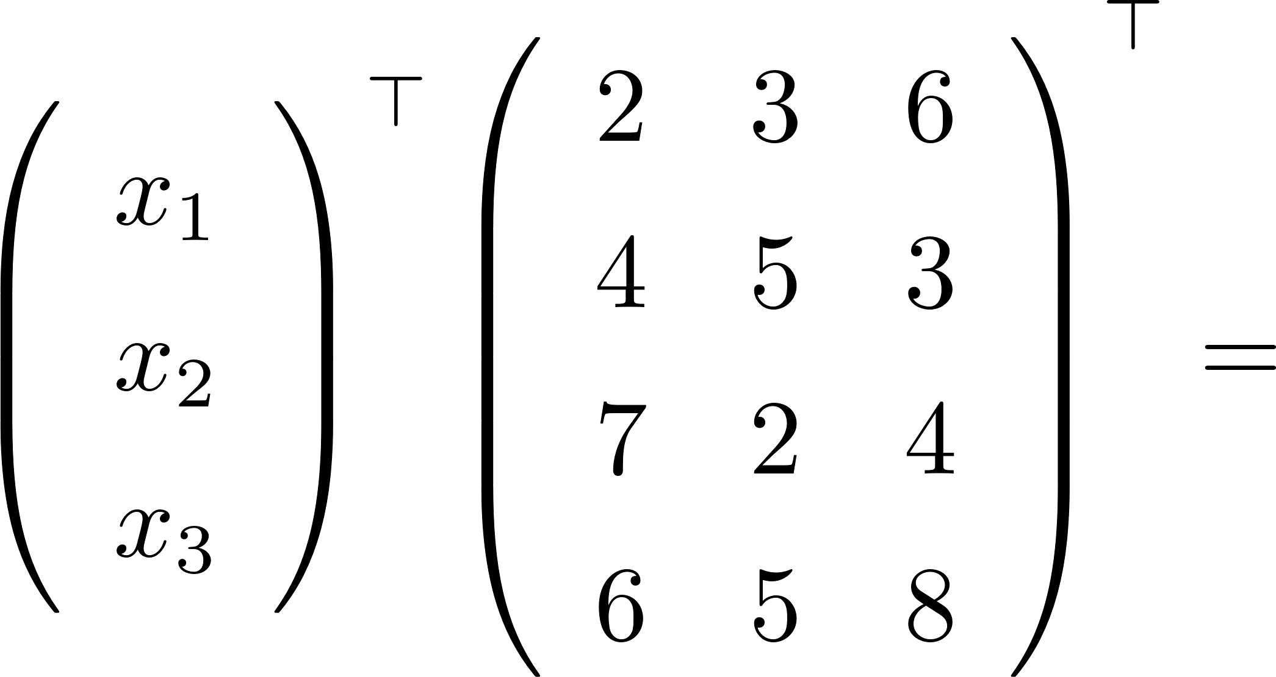
Matrix Multiplication
Notes:
(AB)^{T} = B^{T}A^{T}

